Slide 1
Internet stavri i servisi
Projekat2
Predrag Tosic - 18454

Slide 2





Tehnologije
Database - Postgres
Sensor – Python
Analytics – Python
EventInfo - .Net
MQTT Broker – Mosquitto
Docker

Slide 3
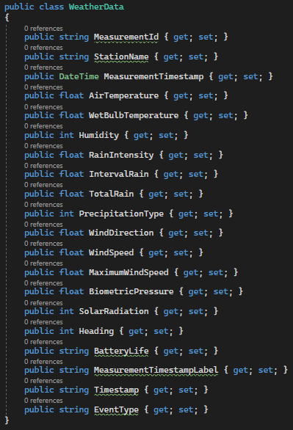
Data set – vremenska prognoza na plazama

Slide 4
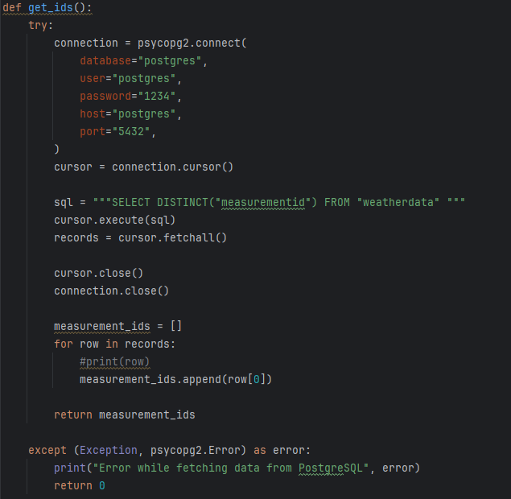
Sensor – pribavljanje svih id-jeva

Slide 5
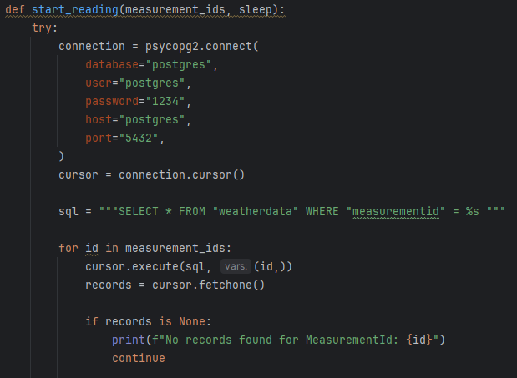
Sensor – citanje podataka iz baze

Slide 6
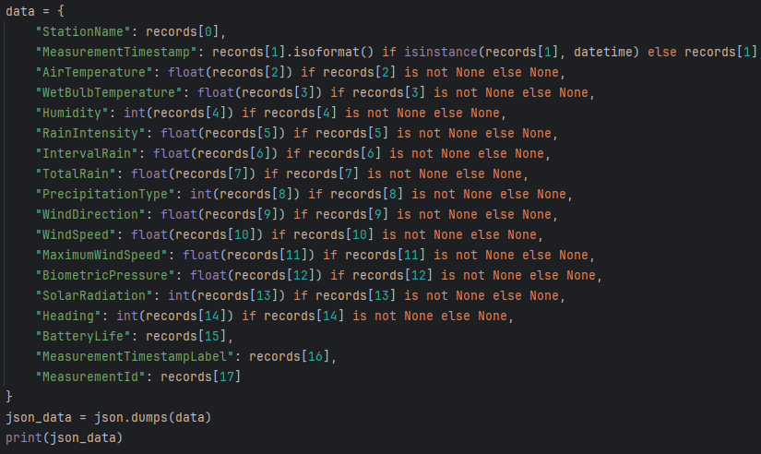
Sensor – kreiranje objekta za slanje

Slide 7
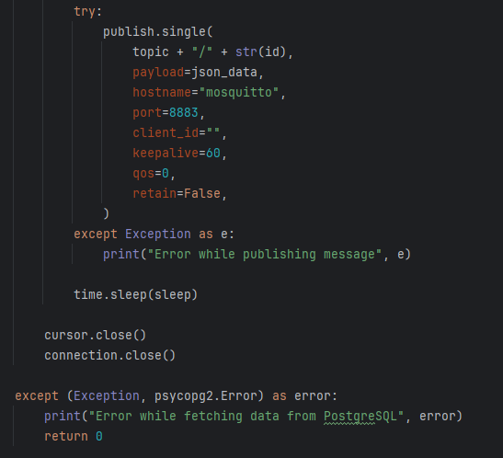
Sensor – slanje podataka

Slide 8
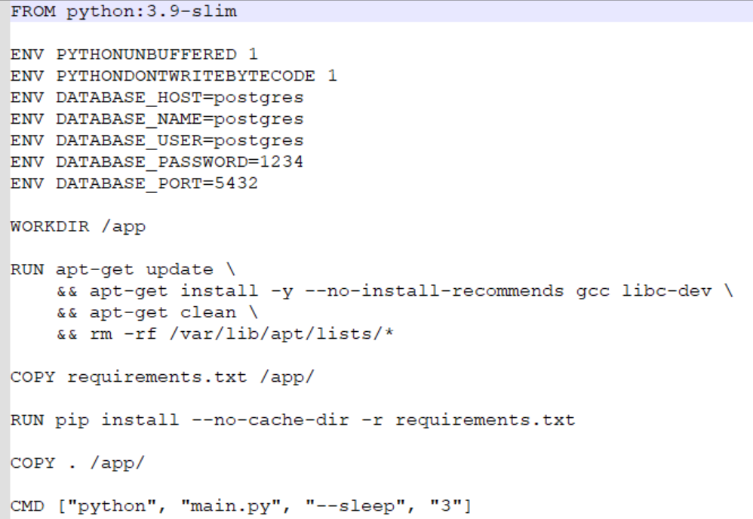
Sensor – Dockerfile

Slide 9
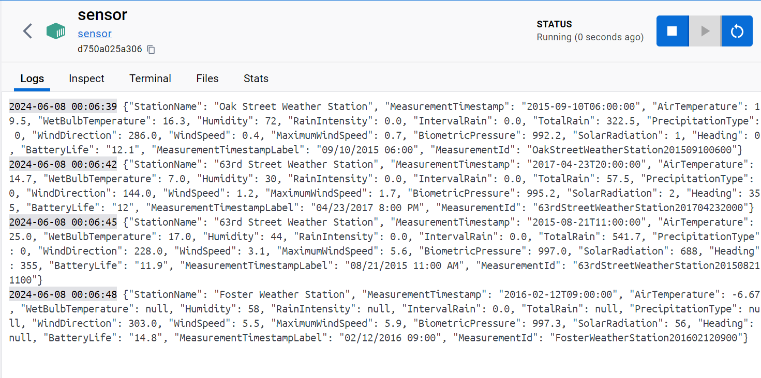
Sensor – docker logs

Slide 10
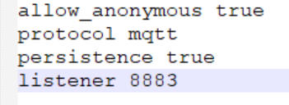
Mosquitto.conf

Slide 11
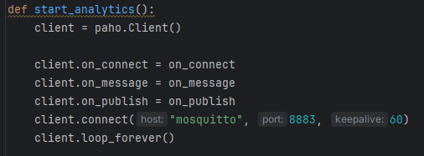

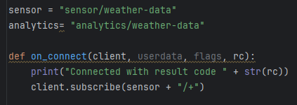
Analytics

Slide 12
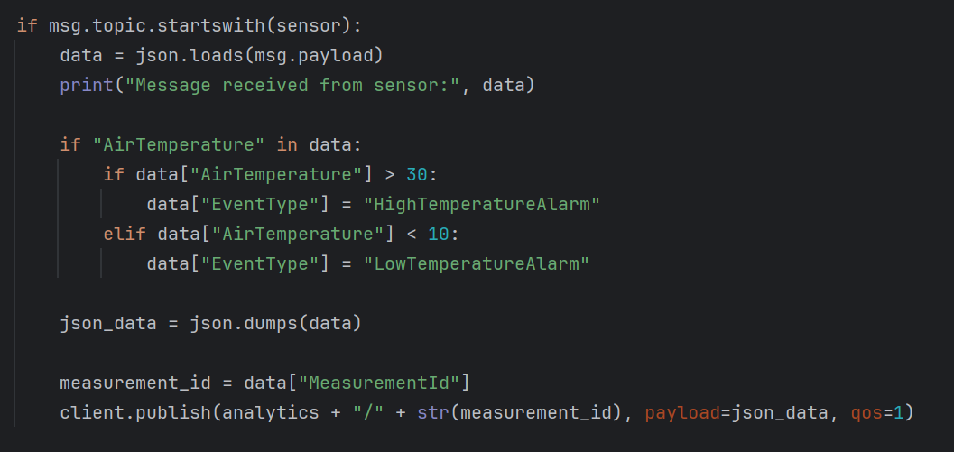
Analytics – prijem, obrada i slanje poruka

Slide 13
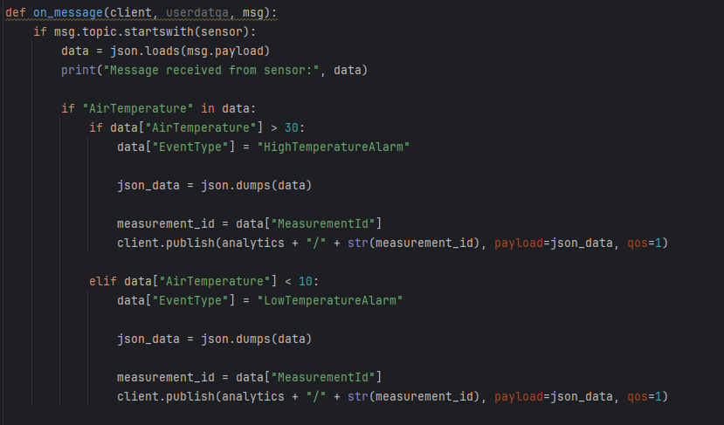
Analytics

Slide 14
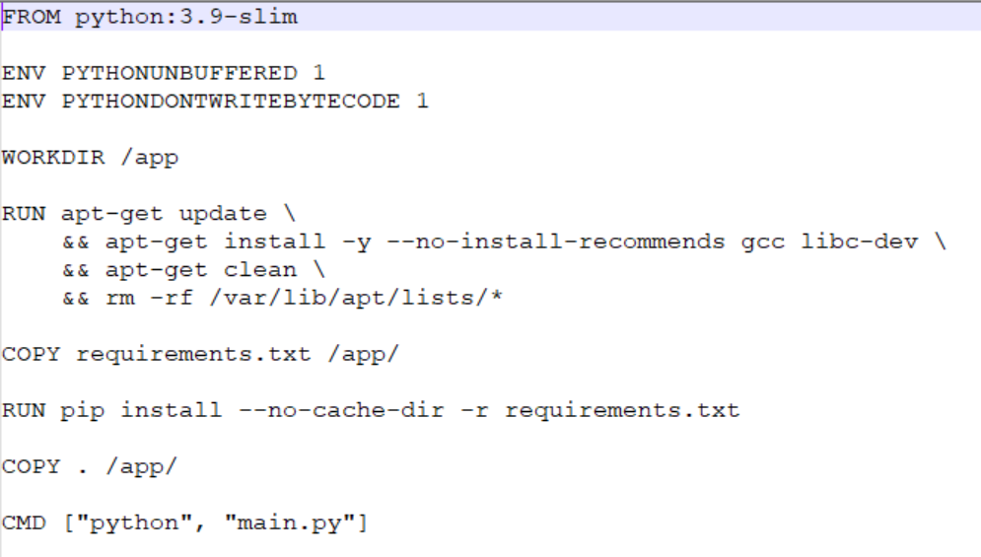
Analytics – Dockerfile

Slide 15
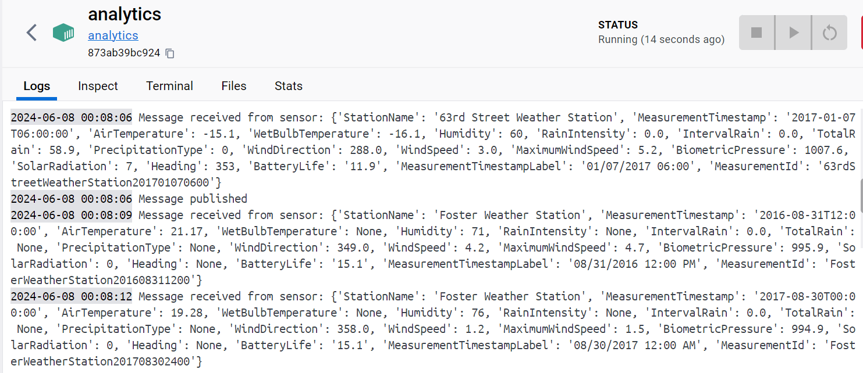
Analytics – docker logs

Slide 16
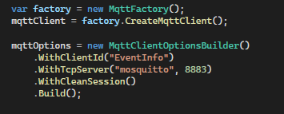
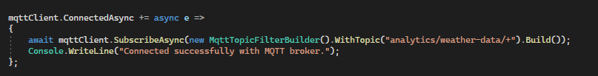
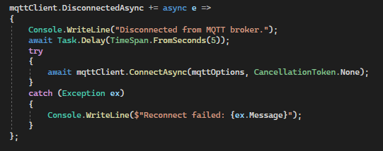
EventInfo

Slide 17
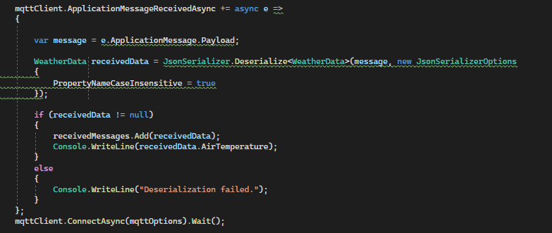
EventInfo

Slide 18
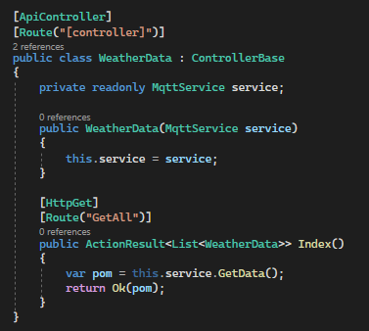
EventInfo - controller

Slide 19
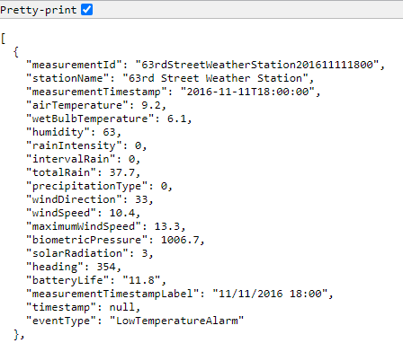
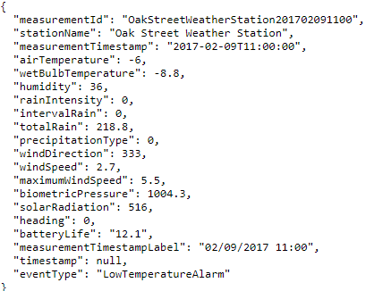
EventInfo – GetAll

Slide 20
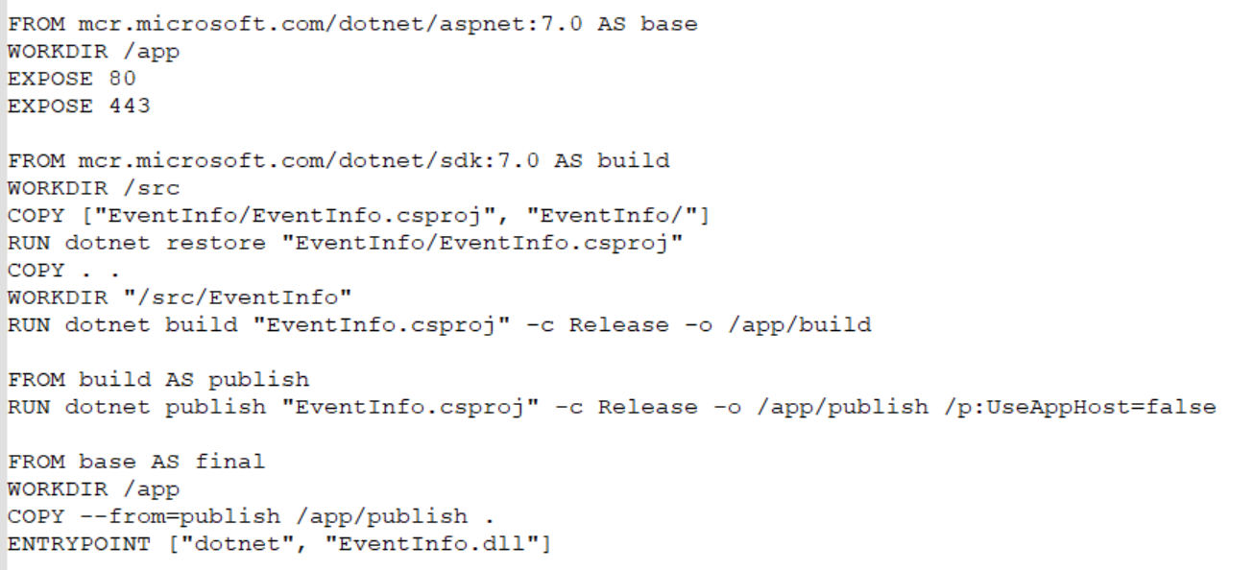
EventInfo – Dockerfile

Slide 21
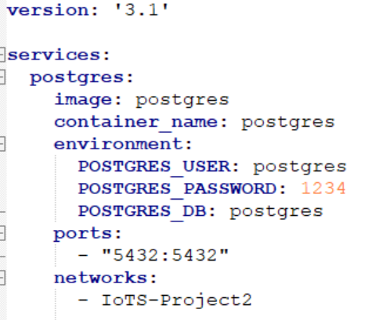
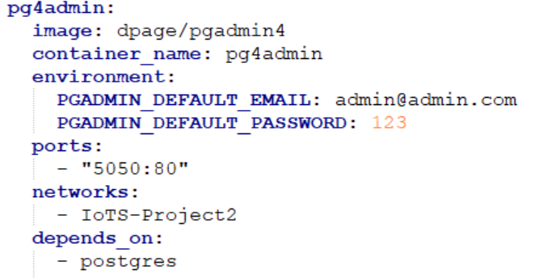
Docker-compose

Slide 22
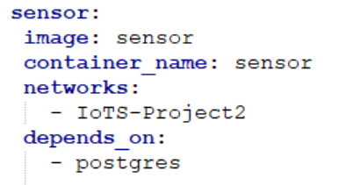
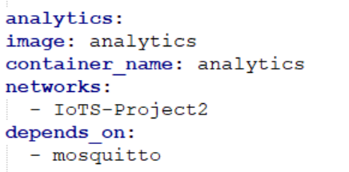
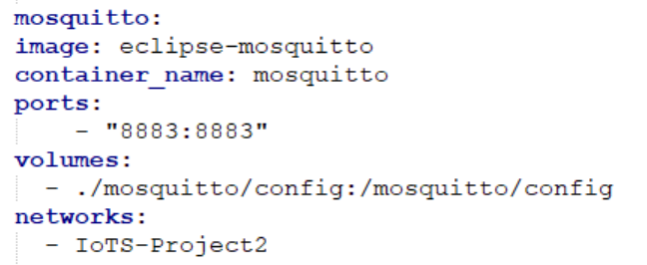
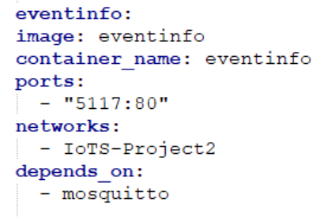

Docker-compose

